Slide 1
Course Outcome 1
To interpret given organization structure, culture, climate and major provisions of factory acts and laws.

Slide 2
Chapter 1
Organizational structure, Organizational Climate
Factory Laws

Slide 3
Organization structure
Definitions: An organizational structure is a system that outlines how certain activities are directed in order to achieve the goals of an organization. These activities can include rules, roles, and responsibilities.
Goal: The primary purpose of a business is to maximize profits for its owners or stakeholders

Slide 4
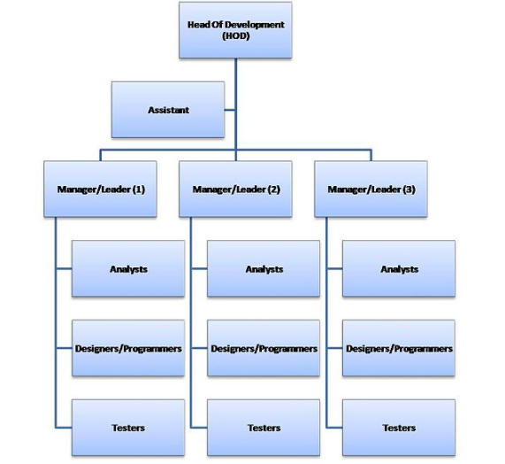
Typical structure of a software company
Decision-makers at the top and doers at the bottom.

Slide 5
Factors considering in formulating structure
1. Company size and development stage
Smaller companies or new businesses, like start ups, often have to operate with an “all hands on deck” mentality where everyone has to wear several different hats. In that case, it doesn’t make sense to have different tiers of managers.
As companies grow larger, become more established, and add more specialized roles, adding a hierarchical structure with managers and department heads

Slide 6
Cont..
2. Business strategy
How could your organizational structure and team structure enhance your company objectives?
software development is an industry where flexibility and speed of innovation is paramount for staying ahead of the competition. Cross-functional teams, work well in this industry because of the need for rapid iteration that would be stymied if each department worked individually. For companies offering different products or services, each product or service might require very different strategies and thereby result in distinct subdivisions.

Slide 7
Cont..
3. Location
We live in a global, digital age. Companies across all industries have to consider how they’ll handle employees who work from home, employees in satellite offices or international offices, partners, freelancers, and the many complexities of the 21st-century workplace. These aren’t just logistical questions but important organizational considerations

Slide 8
Cont..
4. Culture
What do you want your employees to think or feel when they come to work and how can your team structure make that happen? While seemingly intangible, there are a lot of concrete factors that affect a company’s brand––benefits, activities, workspace arrangement, parties, and values, to name a few––which means that you can be purposeful in creating the kind of culture that you want for your employees.

Slide 9
Cont..
5. Technology
Advances in technology make it easier than ever to track various metrics, collect and analyze information, and communicate with others. These aren’t just convenient––they change how businesses operate. How can your company use technology to become more efficient and streamline your organizational structure?

Slide 10
Types of Organizational structure
Hierarchical org structure
Functional org structure
Horizontal or flat org structure
Divisional org structures (market-based, product-based, geographic)
Matrix org structure
Team-based org structure
Network org structure

Slide 11
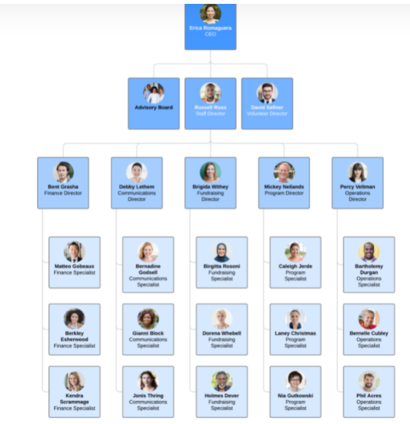
Hierarchical org structure
The pyramid-shaped organizational chart we referred to earlier is known as a hierarchical org chart. It’s the most common type of organizational structure––the chain of command goes from the top (e.g., the CEO or manager) down (e.g., entry-level and low-level employees) and each employee has a supervisor.

Slide 12
PROS
CONS
Better defines levels of authority and responsibility
Shows who each person reports to or who to talk to about specific projects
Motivates employees with clear career paths and chances for promotion
Gives each employee a specialty
Creates camaraderie between employees within the same department
(camaraderie= a feeling of friendship and trust among a group of people who work together)
Can cause employees to act in interest of the department instead of the company as a whole
Can make lower-level employees feel like they have less ownership and can’t express their ideas for the company

Slide 13
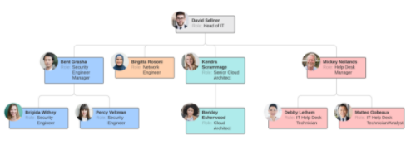
Functional org structure
Similar to a hierarchical organizational structure
A functional org structure starts with positions with the highest levels of responsibility at the top and goes down from there. Primarily, though, employees are organized according to their specific skills and their corresponding function in the company.
Each separate department is managed independently.

Slide 14
PROS
CONS
Allows employees to focus on their role
Encourages specialization
Help teams and departments feel self-determined
Is easily scalable in any sized company
Hampers interdepartmental communication
Obscures processes and strategies for different markets or products in a company

Slide 15

Horizontal or flat org structure
A horizontal or flat organizational structure fits companies with few levels between upper management and staff-level employees. Many start-up businesses use a horizontal org structure before they grow large enough to build out different departments, but some organizations maintain this structure since it encourages less supervision and more involvement from all employees.

Slide 16
PROS
CONS
Gives employees more responsibility
Fosters more open communication
Improves coordination and speed of implementing new ideas
Can create confusion since employees do not have a clear supervisor to report to
Can produce employees with more generalized skills and knowledge
Can be difficult to maintain once the company grows beyond start-up status

Slide 17
Divisional org structures (market-based, product-based, geographic)
In divisional organizational structures, a company’s divisions have control over their own resources, essentially operating like their own company within the larger organization. Each division can have its own marketing team, sales team, IT team, etc.
Depending on your organization’s focus, there’s a few variations to consider.

Slide 18
Cont...
Market-based divisional org structure: Divisions are separated by market, industry, or customer type. A large consumer goods company, like Target or Walmart, might separate its durable goods (clothing, electronics, furniture, etc.) from its food or logistics divisions.
Product-based divisional org structure:
Divisions are separated by product line. For example, a tech company might have a division dedicated to its cloud offerings, while the rest of the divisions focus on the different software offerings––e.g., Adobe and its creative suite of Illustrator, Photoshop, In-Design, etc.

Slide 19
Cont..
c. Geographic divisional org structure
Divisions are separated by region, territories, or districts, offering more effective localization and logistics. Companies might establish satellite offices across the country or the globe in order to stay close to their customers.

Slide 20
PROS
CONS
Helps large companies stay flexible
Allows for a quicker response to industry changes or customer needs
Promotes independence, autonomy, and a customized approach
Can easily lead to duplicate resources
Can mean muddled or insufficient communication between the headquarters and its divisions
Can result in a company competing with itself

Slide 21
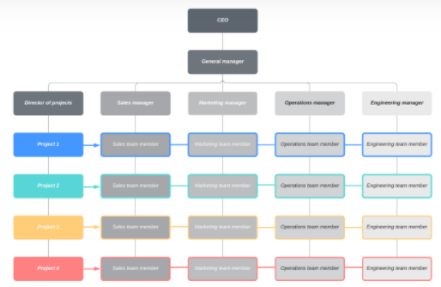
Matrix org structure
A matrix organizational chart looks like a grid, and it shows cross-functional teams that form for special projects. For example, an engineer may regularly belong to the engineering department (led by an engineering director) but work on a temporary project (led by a project manager). The matrix org chart accounts for both of these roles and reporting relationships.

Slide 22
PROS
CONS
Allows supervisors to easily choose individuals by the needs of a project
Gives a more dynamic view of the organization
Encourages employees to use their skills in various capacities aside from their original roles
Presents a conflict between department managers and project managers
Can change more frequently than other organizational chart types

Slide 23
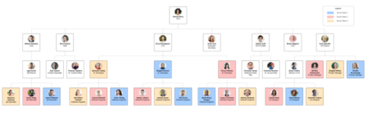
Team-based org structure
A team organizational structure is meant to disrupt the traditional hierarchy, focusing more on problem solving, cooperation, and giving employees more control

Slide 24
PROS
CONS
Increases productivity, performance, and transparency by breaking down silos
Promotes a growth mindset
Changes the traditional career models by getting people to move laterally
Values experience rather than seniority
Requires minimal management
Fits well with agile companies with scrum or tiger teams
Goes against many companies’ natural inclination of a purely hierarchical structure
Might make promotional paths less clear for employees

Slide 25
Network org structure
It is a temporary or permanent arrangement of otherwise independent organizations or associates, forming an alliance to produce a product or service by sharing costs and core competencies.
E.g. H & M (Swedish Company) outsourced the production and processing of their goods to different countries majorly Asian and South East Asian Countries.

Slide 26
PROS
CONS
Visualizes the complex web of onsite and offsite relationships in companies
Allows companies to be more flexible and agile
Give more power to all employees to collaborate, take initiative, and make decisions
Helps employees and stakeholders understand workflows and processes
Can quickly become overly complex when dealing with lots of offsite processes
Can make it more difficult for employees to know who has final say

Slide 27
Organizational culture & Climate
Org Culture Meaning:
Organizational culture is the collection of values, expectations, and practices that guide and inform the actions of all team members
Don’t confuse culture with organizational goals or a mission statement, although both can help define it. Culture is created through consistent and authentic behaviours, not press releases or policy documents. You can watch company culture in action when you see how a CEO responds to a crisis, how a team adapts to new customer demands, or how a manager corrects an employee who makes a mistake.
“It is not something you are, It is something you do”

Slide 28
Cont..
Org Climate Meaning:
“Climate in natural sense is referred to as the average course or condition of the weather at a place over a period of years as exhibited by temperature, wind, velocity and precipitation.”
Climate of an organisation is somewhat like the personality of a person. Just as every individual has a personality that makes him unique and different from other persons. Each organisation has an organisational climate that clearly distinguishes it from other organisations.

Slide 29
Cont..
According to Campbell, “Organisational climate can be defined as a set of attributes specific to a particular organisation that may be induced from the way that organisation deals with its members and its environment. For the individual members within the organisation, climate takes the form of a set of attitudes and experiences which describe the organisation in terms of both static characteristics (such as degree of autonomy) and behaviour outcome and outcome- outcome contingencies.”

Slide 30
Org Culture VS Org Climate
Difference between organizational culture and organizational climate is that the culture is about the norms, values and behaviour adopted by the employees within the organization while the climate is about the atmosphere of the organization that is created based on the culture

Slide 31
Factors affecting Org Culture
1. Top Leadership Principles: How an organization’s leadership team runs the business affects the policies, procedures and rules set for employees
2. Nature Of The Business: The purpose, market and operations of an organization have an impact on employees’ behaviour.
3. Company Values, Policies and Work Ambiance: Employees develop the values emphasized in the policies, procedures and work environment.

Slide 32
Cont..
4. Clients and External Parties:
Why are clients part of the culture? Because these are the people that directly affect the employee’s well being. If a customer is upset and takes it out on an employee, that employee’s behaviour directly impacts those around them. If a client has a big success and thanks the employee for a job well done, that employee can uplift their whole team.
5. Recruitment and Selection:
The type of employees hired by an organization has the largest effect on its culture – especially when a company is in high growth mode and is rapidly adding new employees.

Slide 33
Factors affecting Org Climate
1. Organizational content: The reactions of the employees and the degree to which they welcome and accept the managerial philosophy is very crucial to the development of sound and favourable organizational climate.
2. Structure: Structure is the framework that establishes formal relationship and delineates authority and functional responsibility.

Slide 34
Cont..
3. Process: In every organization certain processes are vital so that it functions. Communication, decision making, motivation and leadership are some of the important processes through which management achieves the tasks. For instance, if we consider leader-follower relationship, leadership process, it is leader’s choice whether to allow subordinates in decision-making, give assignments, etc. A leader has to be aware of the possible influence of his actions on the climate while deciding about the most appropriate supervisory technique for a given situation.

Slide 35
Cont..
4. Physical Environment: the external conditions of environment, the size, location of the work place etc., will also affect organizational climate. An employee performing his job in relatively clean, quiet, safe environment will undoubtedly have a favourable perception of the organizational climate.
5. System Values and Norms: Every organization has discernible and fairly formal value system where certain kinds of behaviours are rewarded and encouraged and certain kinds of behaviour forces an individual to formal sanctions. The formal value system is communicated to employees through rules, regulations and policies. But informal value system is very difficult to ascertain. But both exert influence on organizational climate.

Slide 36
1.6 Morale
Flippo has described morale “as a mental condition or attitude of individuals and groups which determines their willingness to co-operate. Good morale is evidenced by employee enthusiasm, voluntary confirmation with regulations and orders, and a willingness to co-operate with others in the accomplishment of an organization’s objectives. Poor morale is evidenced by surliness, insubordination, a feeling of discouragement and dislike of the job, company and associates.

Slide 37
Types of Morale
The following are the two types of morale:
1. Individual and Group Morale:
Individual morale is a single person’s attitude towards work, environment etc. Whereas group morale reflects the general attitude of a group of persons.
2. High or Low Morale:
In the words of McFarland, high morale exists when employee attitudes are favourable to the total situation of a group and to the attainment of its objectives. Low morale exists when attitudes inhibit the willingness and ability of an organization to attain its objectives. The words such as zeal, enthusiasm, loyalty, dependability denote high morale. Low morale may be described by words like lack of interest, laziness, apathy, bickering, jealousy, quarrelsome, pessimism, etc.

Slide 38
Factors affecting Morale
1. The Organization : The organization influences the worker’s attitudes to their jobs. The public reputation of an organization may build up for better or worse, their attitudes towards it.
2. The Nature of Work:
The nature of the work, the worker is expected to perform also affects his attitude towards the job as well as his morale. If the employee is expected to perform routine or specialized jobs, he will feel bored and alienated. Repetition of the same task again and again makes the working situation worse for the employees. Another factor is the large impersonal organizational structure. Sometimes, if the employee feels that he is just a cog in the machine instead of a person, his morale will become very low. Lack of understanding of organizational goals may also affect the morale.

Slide 39
Cont..
3. The Level of Satisfaction:
The level of satisfaction, a worker derives from his job is another determinant of morale. If the job factors and the satisfaction they bring is perceived to be favourable by the employee morale will tend to be higher than if there factors seem to be unfavourable. The job factors include the factors such as opportunities for promotions, job security, steadiness of employment, opportunities to learn the job and to use his own ideas, pay working conditions, recognition, cooperativeness of co-workers, group relationship etc.

Slide 40
Cont..
4. The Level of Supervision:
The level of supervision received by an employer has a tremendous influence on his morale. High rate of employee turnover indicates that the leadership is ineffective. On the other hand, if employees are given freedom to do the job, their morale will be high. Nobody likes to be supervised all the time.

Slide 41
Cont..
5. Concept of Self:
What is the employee’s concept of himself? The answer to this question influences the attitudes of the employees to the organizational environment. How an employee perceives himself, is a very important question.
6. Worker’s Perception of Rewards System:
The worker’s perception of past rewards and future opportunities for rewards affect their morale to a substantial extent. If the workers regard the rewards as fair and satisfactory, their morale will tend to by higher than if the perception is in the opposite direction.

Slide 42
Cont..
7. The Employee’s Age:
Studies have reported that age and morale are directly related. Other things being equal, elder employees seem to have higher morale. This is because of the reason that perhaps younger workers are more dissatisfied with higher expectations than their elders. The older employees have more stability which comes with maturity, a serious attitude towards job.
8. The Employee’s Educational Level:
Studies have concluded an inverse relationship in the educational level of the employee and his morale. Higher the educational level lower will be the job satisfaction and vice versa

Slide 43
Cont..
9. The Employee’s Occupational Level:
The occupational level of the employee also influences his level of morale. The higher up in organisational hierarchy an employee is higher will be his morale. The morale of the people who are lower in the levels of hierarchy is generally low because they compare their own attainments with those of others.

Slide 44
Cont..
10. The Off the Job Activities of the Employee: The relationship of an employer with his family and work group influences his behaviour and attitude while he is on the job. His off the job activities e.g. whether his family life is happy or not, whether he has excessive drinking habits etc.

Slide 45
Relationship between morale and productivity
Morale reflects the attitude of employees towards their work, it will be of interest to know if it has any bearing on productivity.
A number of research studies reveal that there is no direct relationship between morale and productivity. High morale may lead to higher productivity but in some cases production may go down even.
It is generally felt there is a positive relation between morale and productivity but the degree may not be the same. For example, 10 per cent increase in morale may lead to higher productivity but production may not necessarily increase by 10 per cent.

Slide 46
Cont..
Miller and Form have given four combinations of productivity and morale:
High productivity-high morale: The first situation occurs when the individual is satisfied from the job and prevailing environment. He will try to achieve high standards of performance which will lead to higher productivity

Slide 47
Cont..
2. Low productivity high morale:
In this situation the employee may be satisfied from his work and situations prevailing, showing high morale. Lack of proper teaching of the employee, lack of administrative skill of the supervisor, defective materials, out-dated technology may lead to low productivity in-spite of high morale.

Slide 48
Cont..
3. High productivity-low morale:
In the third-situation, management may use strict supervision, prescribe punishments for low productivity and use better technology for raising productivity in-spite of low morale.
4. Low productivity-low morale:
The fourth situation occurs where factors obtained in combination of high productivity high morale are lacking. There is a complexity of relationship between morale and productivity. This relationship cannot always be predicted. It may differ from organization to organization and from one time to another time.

Slide 49
Job Satisfaction
Factors Influencing job satisfaction:
Working Environment
Fair policies and practices
Caring Organization
Appreciation
Pay
Age
Promotion
Feel of belongings
Leadership
Feel of being loved
Safety & security
Challenges
Responsibilities
Creativity in Job
Personal interest and hobbies
Respect from co-workers
Relationships with supervisor
Feedback
Flexibility
Nature of Work

Slide 50
Important provision of factory act & Labour laws
The main objectives of the Indian Factories Act, 1948 are to regulate the working conditions in factories, to regulate health, safety welfare, and annual leave and enact special provision in respect of young persons, women and children who work in the factories.

Slide 51
Cont..
There are two broad categories of labour law. First, collective labour law relates to the tripartite relationship between employee, employer and union. Second, individual labour law concerns employees' rights at work and through the contract for work.

Slide 52
The Factories Act, 1948 contains the following provisions relating to Labour Welfare:
(1) Washing Facilities:
In every factory (a) adequate and suitable facilities shall be provided and maintained for the use of workers; (b) separate and adequately screened facilities shall be provided for the use of male and female workers; (c) such facilities shall be easily accessible and shall be kept clean

Slide 53
Cont..
(2) Facilities for storing and drying clothing:
In every factory provision for suitable place should exist for keeping clothing not worn during working hours and for the drying of wet clothing
(3) Facilities for sitting:
In every factory, suitable arrangements for sitting shall be provided and maintained for all workers who are obliged to work in a standing position so that the workers may take advantage of any opportunity for rest which may occur in the course of work.

Slide 54
Cont..
(4) First aid appliances:
Under the Act, the provisions for first-aid appliances are obligatory. At least one first-aid box or cupboard with the prescribed contents should be maintained for every 150 workers. It should be readily accessible during all working hours.
Each first-aid box or cupboard shall be kept in the charge of a separate responsible person who holds a certificate in the first-aid treatment recognised by the State Government.
In every factory wherein more than 500 workers are ordinarily employed there shall be provided and maintained an ambulance room of the prescribed size containing the prescribed equipment.

Slide 55
Cont..
(5) Canteens:
In every factory employing more than 250 workers, the State government may make rules requiring that a canteen or canteens shall be provided for the use of workers. Such rules may provide for (a) the date by which the canteen shall be provided, (b) the standards in respect of constitution, accommodation, furniture and other equipment of the canteen; (c) the foodstuffs to be served therein and charges which may be paid thereof; (d) the constitution of a managing committee for the canteens and representation of the workers in the management of the canteen; (e) the items of expenditure in the running of the canteen which are not to be taken into account in fixing the cost of foodstuffs and which shall be borne by the employer; (f) the delegation to the Chief inspector, of the power to make rules under clause (c).

Slide 56
Cont..
(6) Shelters, rest rooms and lunch rooms:
In every factory wherein more than 150 workers are ordinarily employed, there shall be a provision for shelters, rest room and a suitable lunch room where workers can eat meals brought by them with provision for drinking water.
Where a lunch room exists, no worker shall eat any food in the work room. Such shelters or rest rooms or lunch rooms shall be sufficiently lighted and ventilated and shall be maintained in a cool and clean condition.

Slide 57
Cont..
(7) Crèches:
In every factory wherein more than 30 women workers are ordinarily employed there shall be provided and maintained a suitable room or rooms for the use of children under the age of six years of such women.
The State government may make rules for the provision of additional facilities for the care of children belonging to women workers including suitable provision of facilities:—
(a) For washing and changing their clothing
(b) of free milk or refreshment or both for the children, and
(c) for the mothers of children to feed them at the necessary intervals

Slide 58
Cont..
(8) Welfare officers:
In every factory wherein 500 or more workers are ordinarily employed, the occupier shall employ in the factory such number of welfare officers as may be prescribed under Sec. 49(1). The State government may prescribe the duties, qualifications and conditions of service of such officers.

